Slide 1
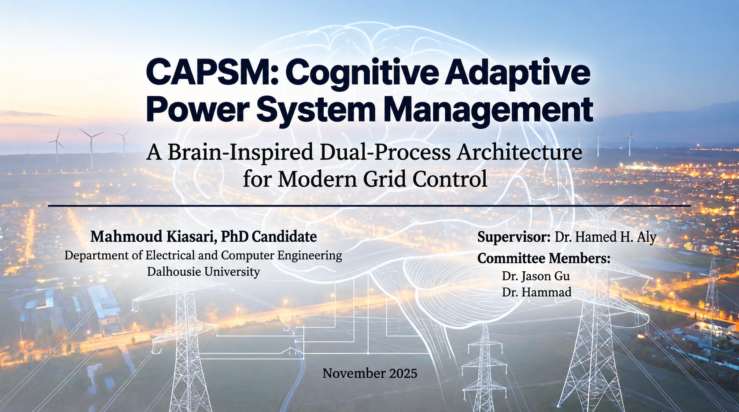

Sep 2026
1

Slide 2
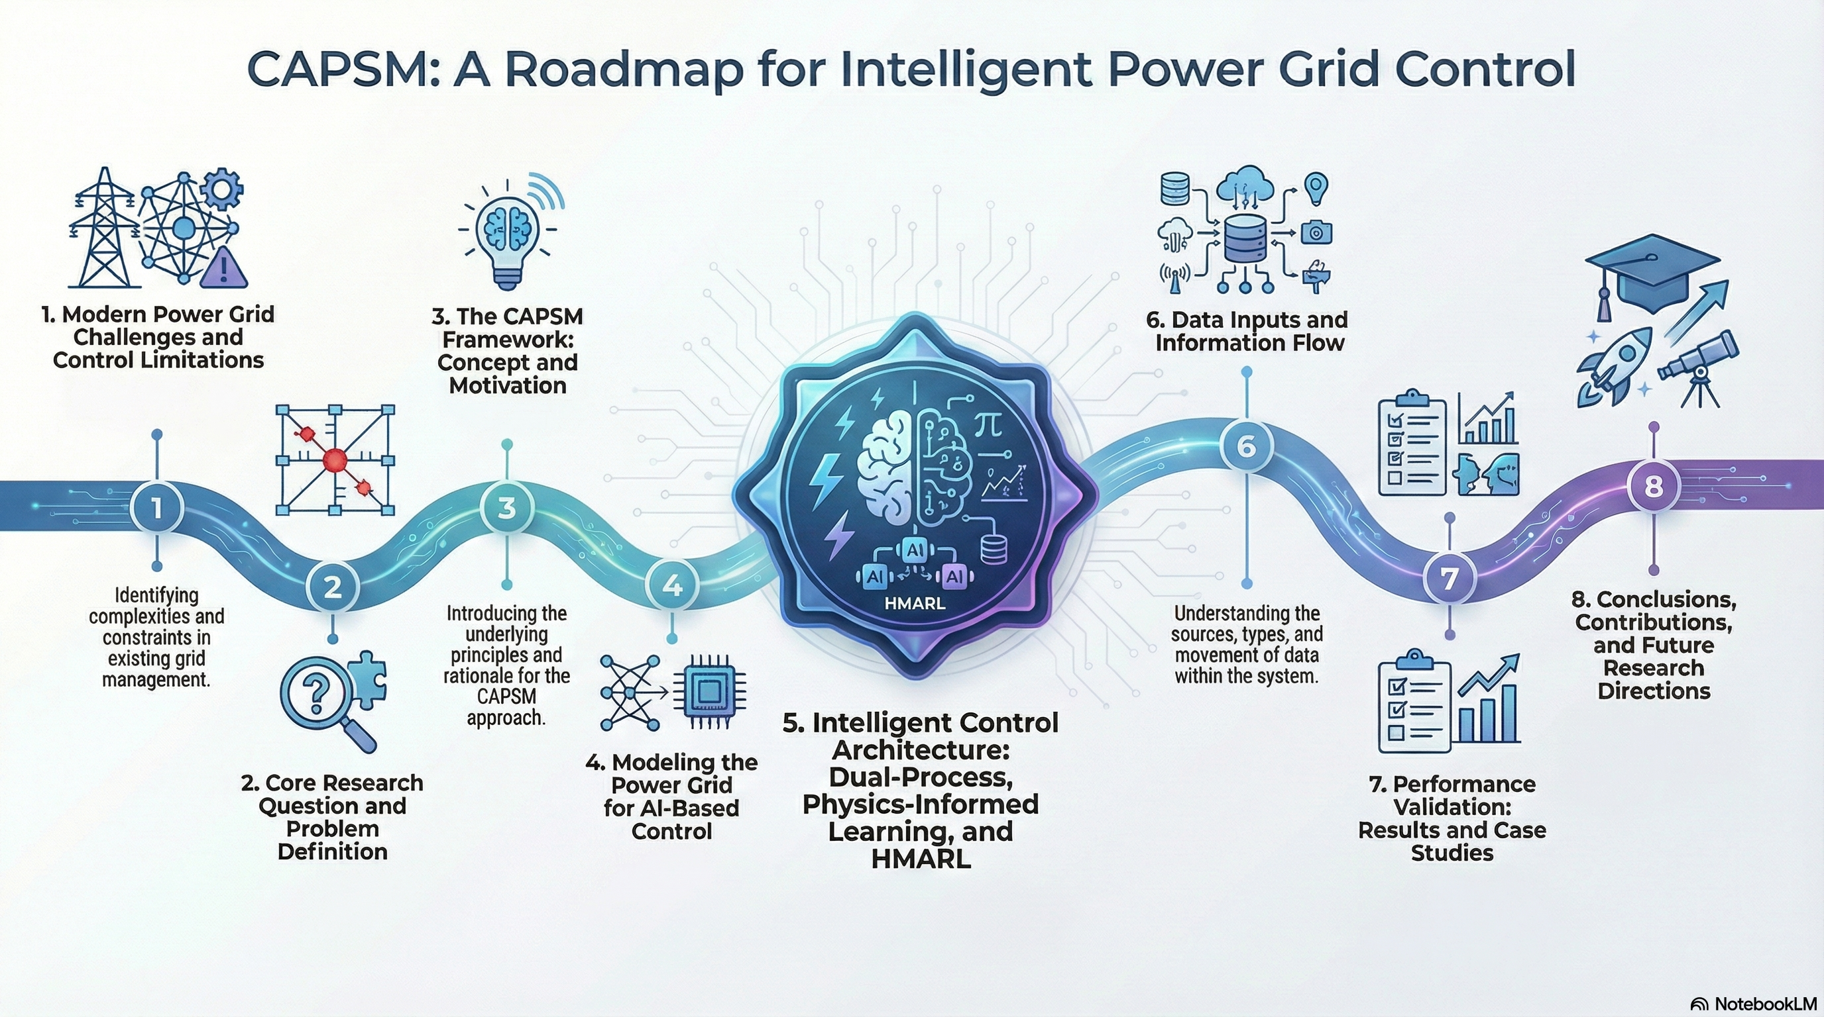
2

Slide 3
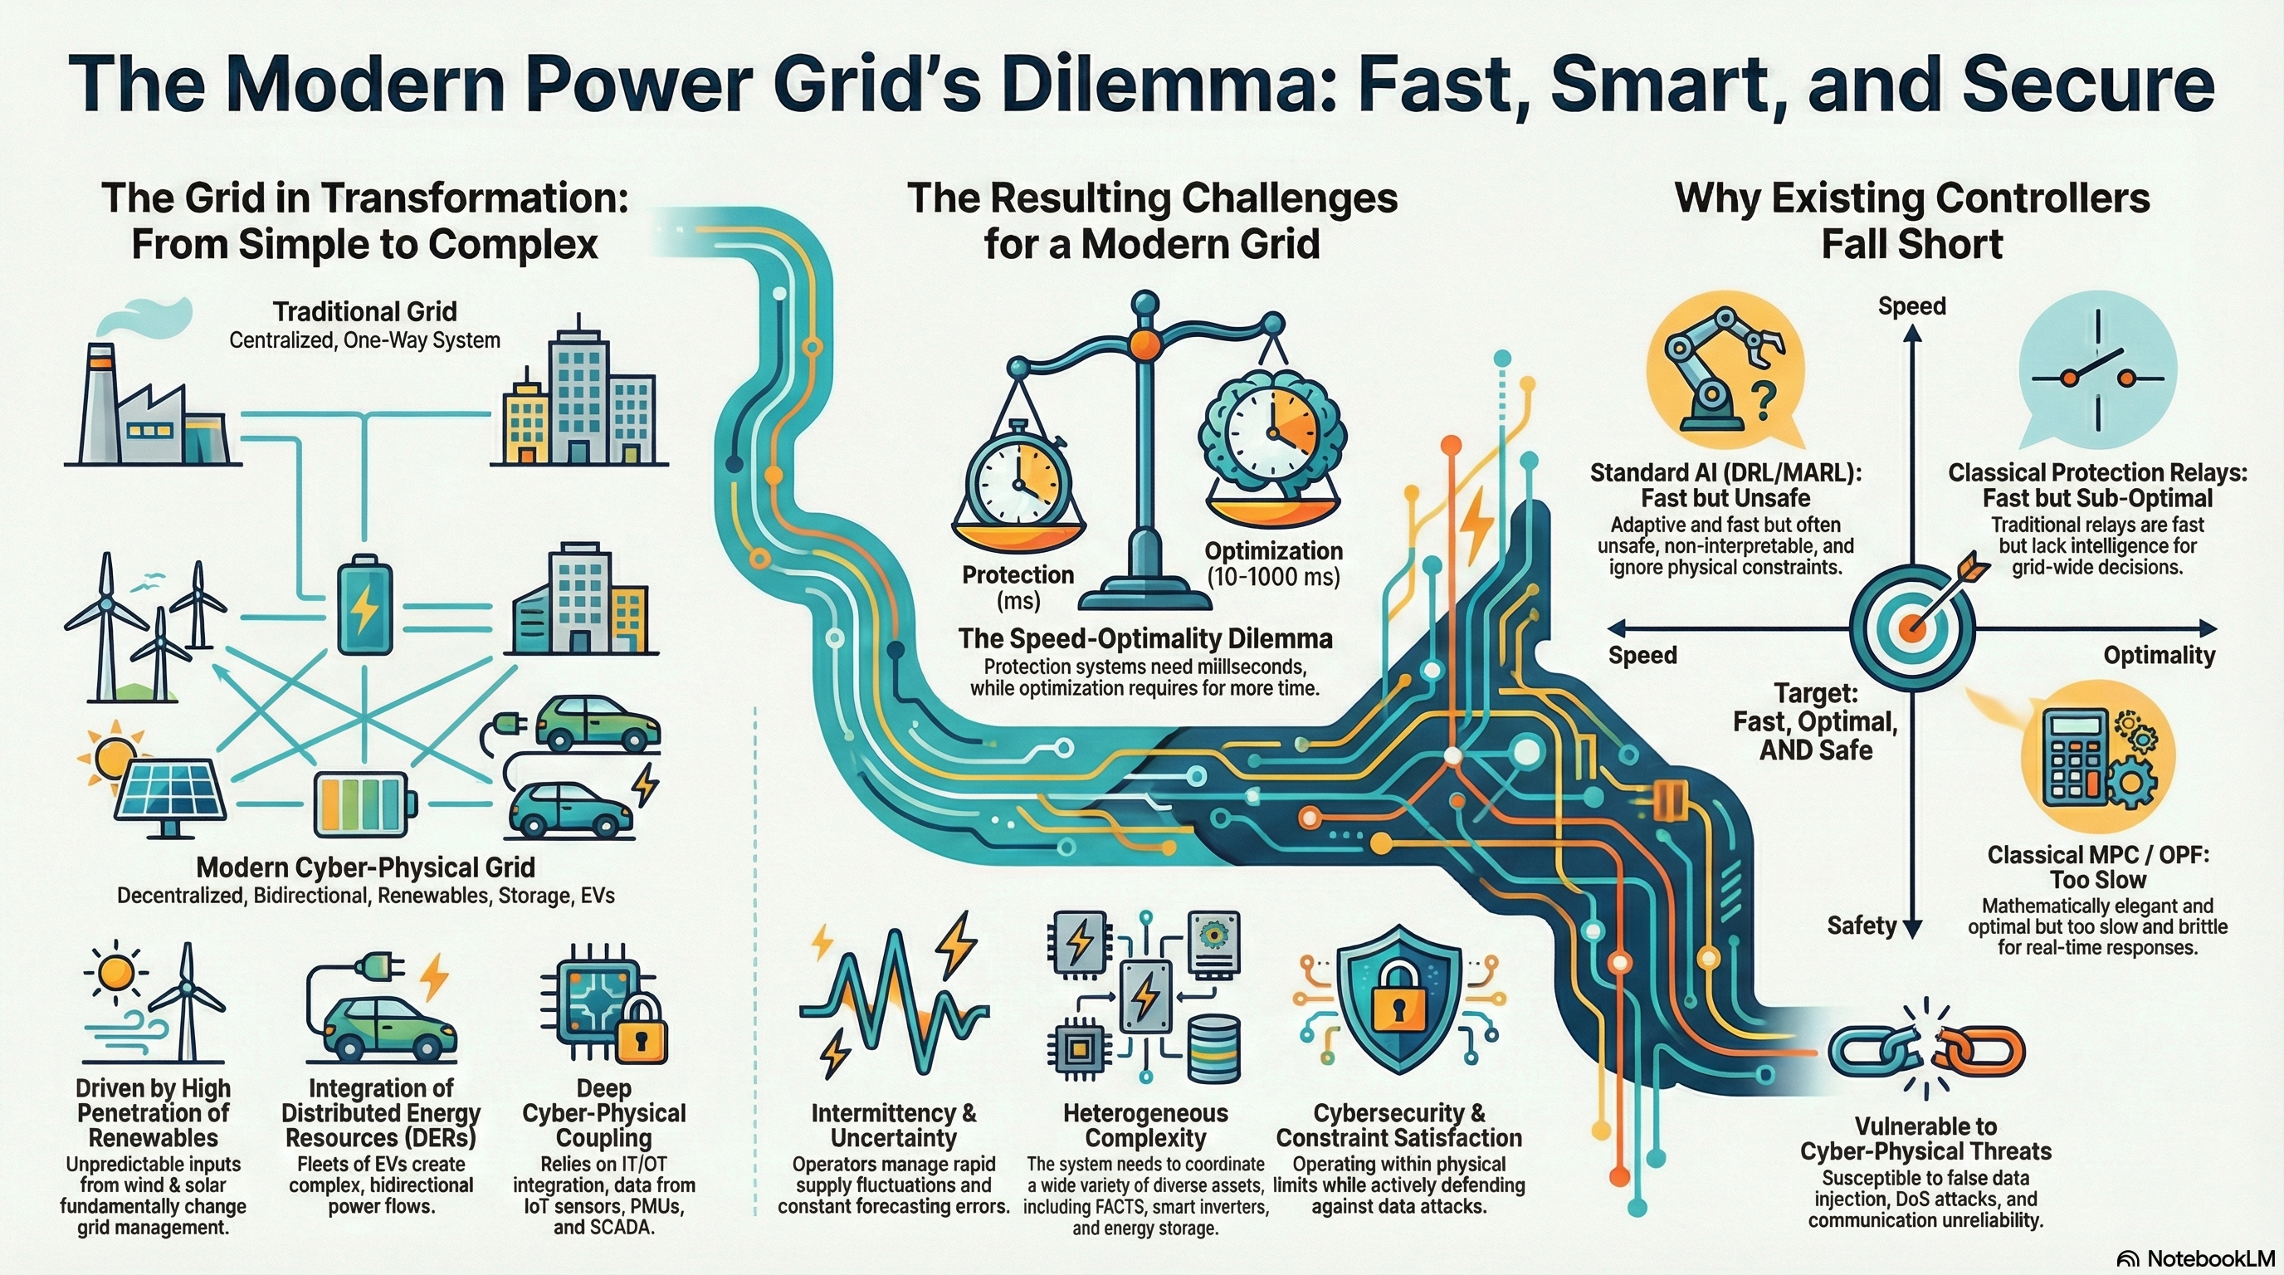
3

Slide 4
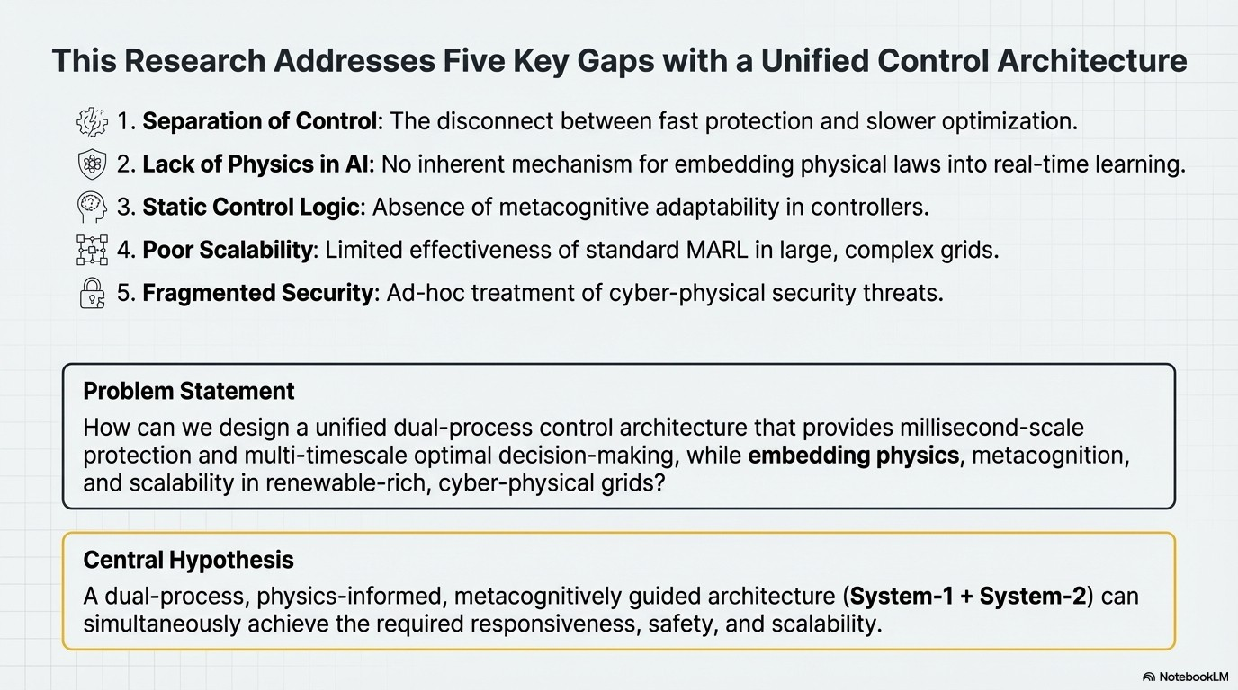
4

Slide 5
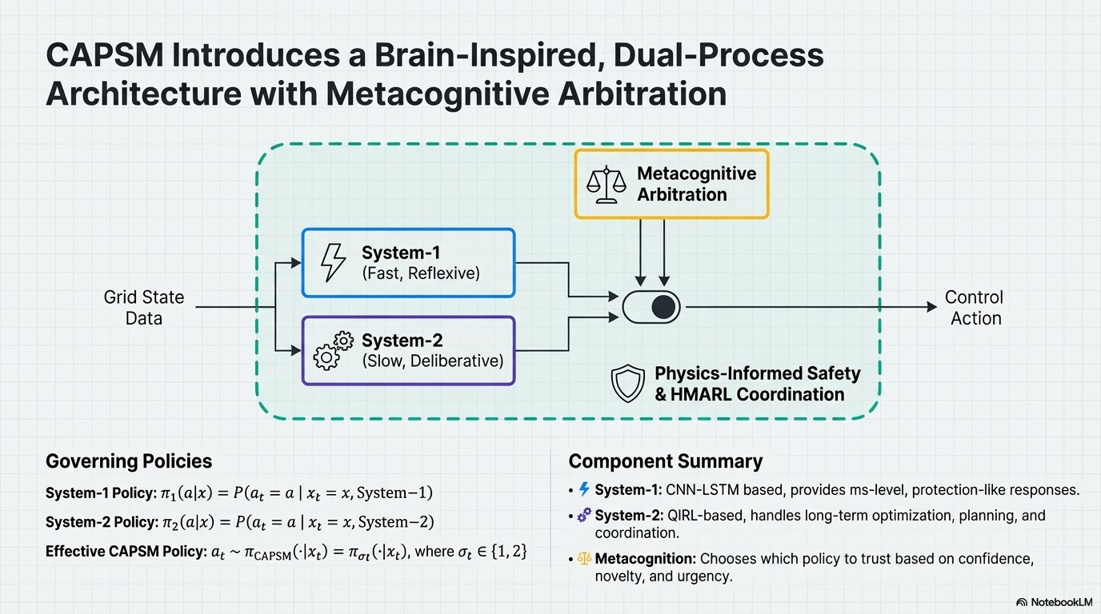
5

Slide 6
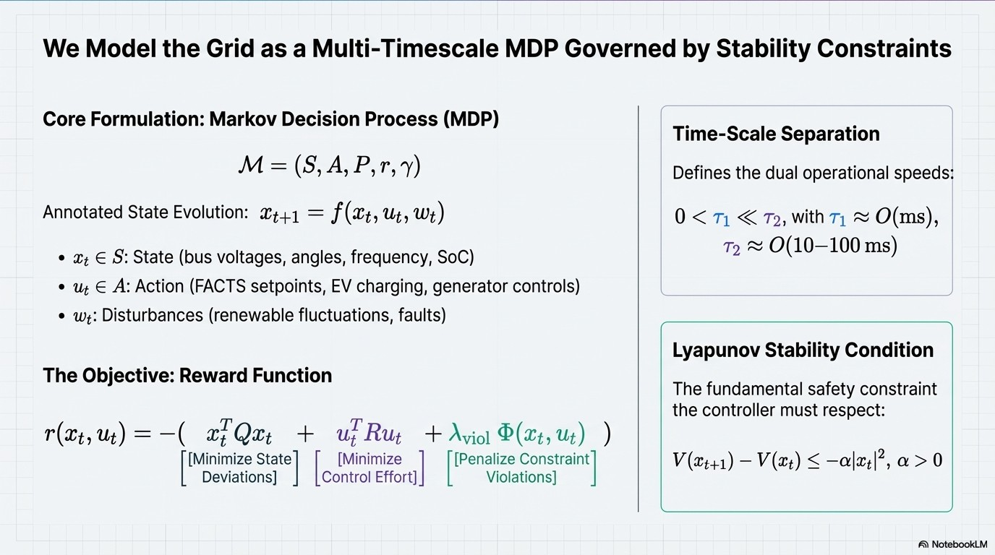
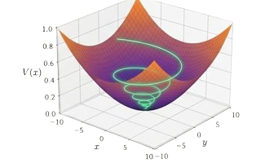
6
Notes:
Model the grid for the AI based controller:
It means converting the physical power system into a mathematical and simulation environment where the AI can observe grid states, issue control actions, and evaluate the resulting electrical response. In my work, this includes buses, generators, transmission lines, loads, FACTS devices, and aggregated EV stations. The AI does not control an abstract dataset; its decisions are evaluated through the physical power-flow model.

Slide 7
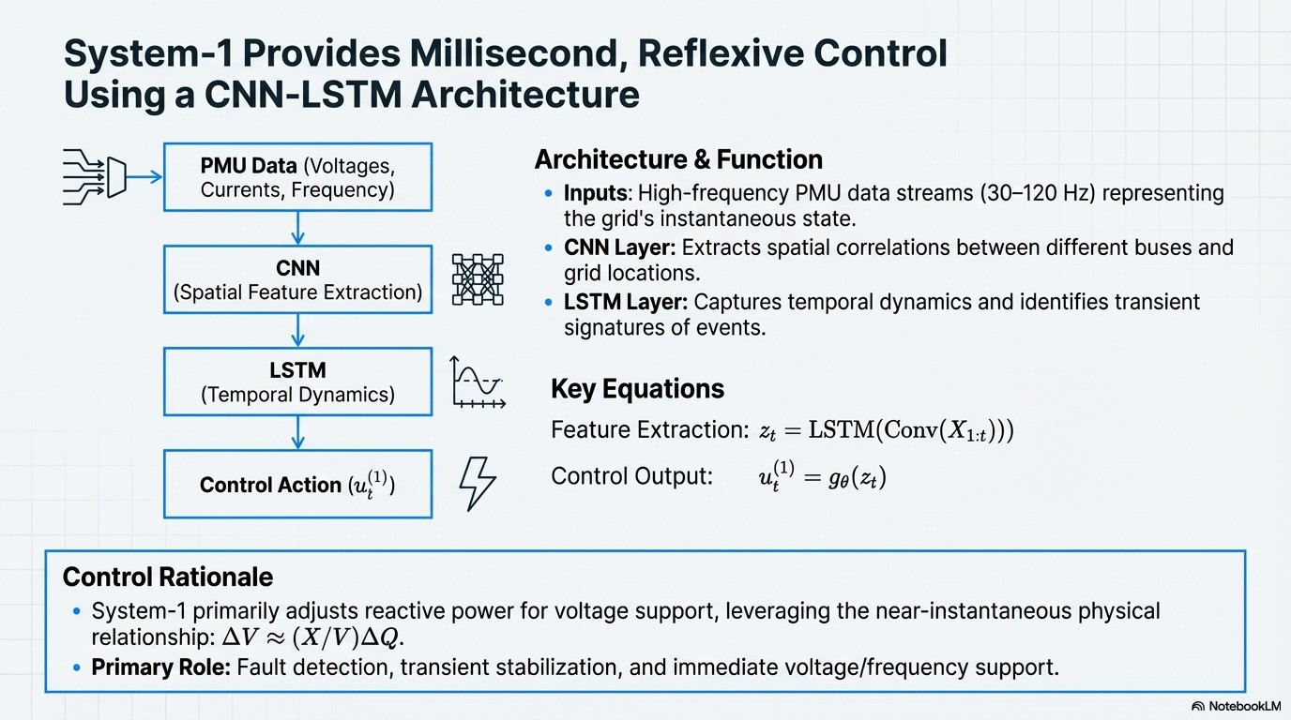
7

Slide 8
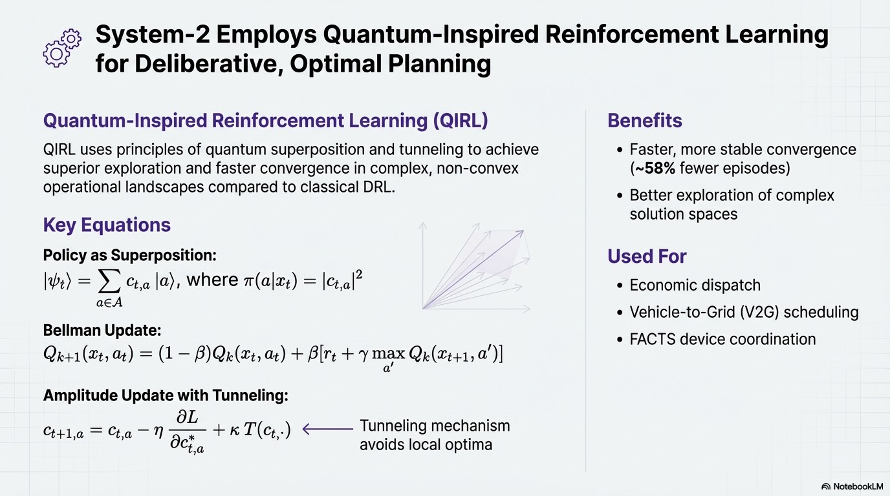
8

Slide 9
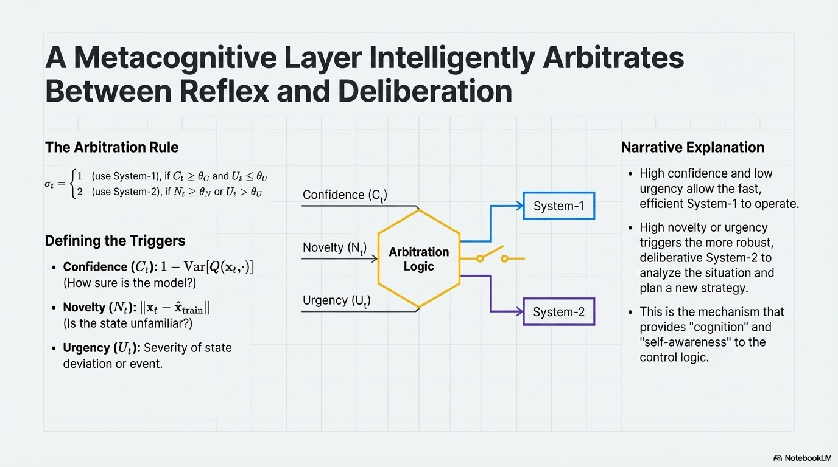
9

Slide 10
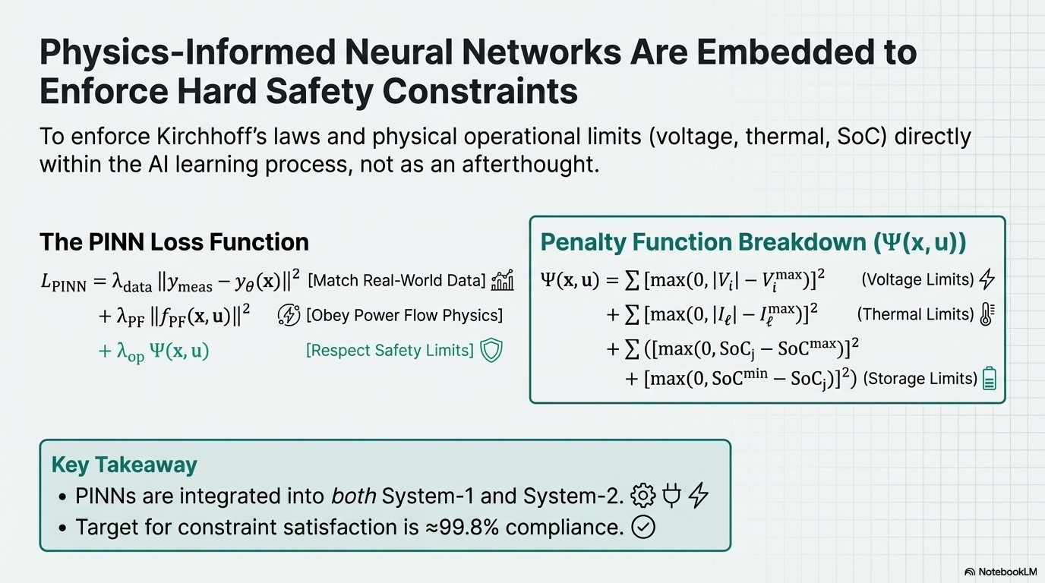
10

Slide 11
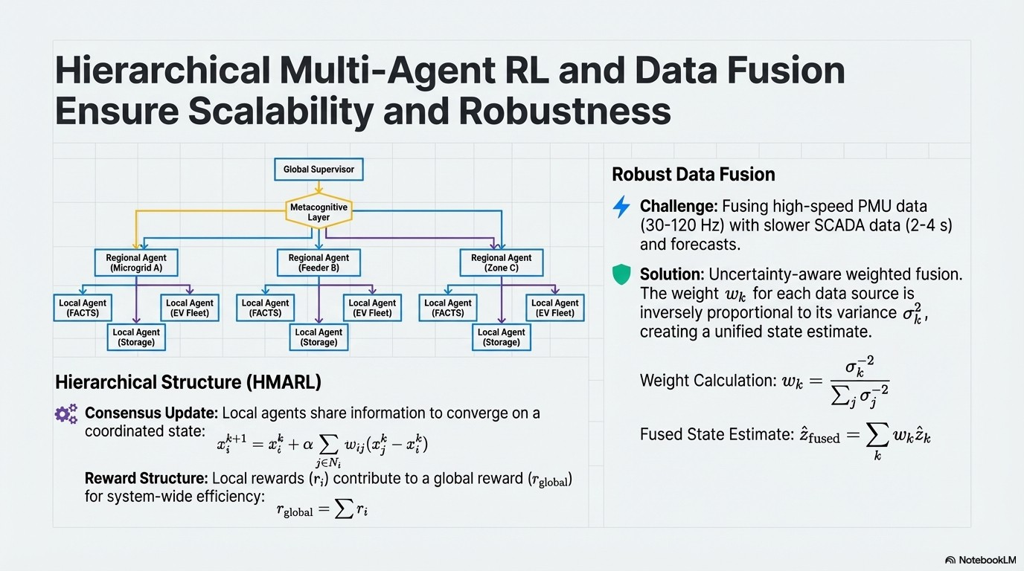
11

Slide 12
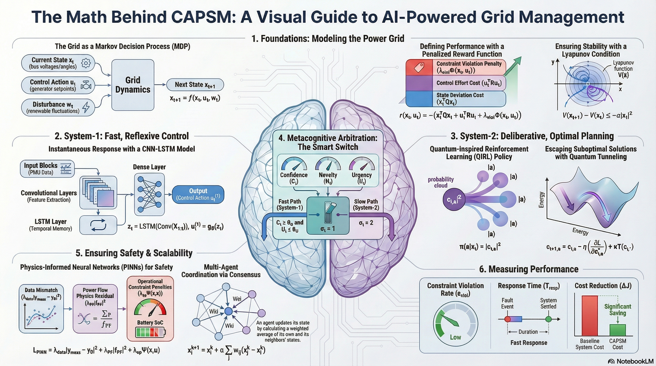
Time-table
12

Slide 13
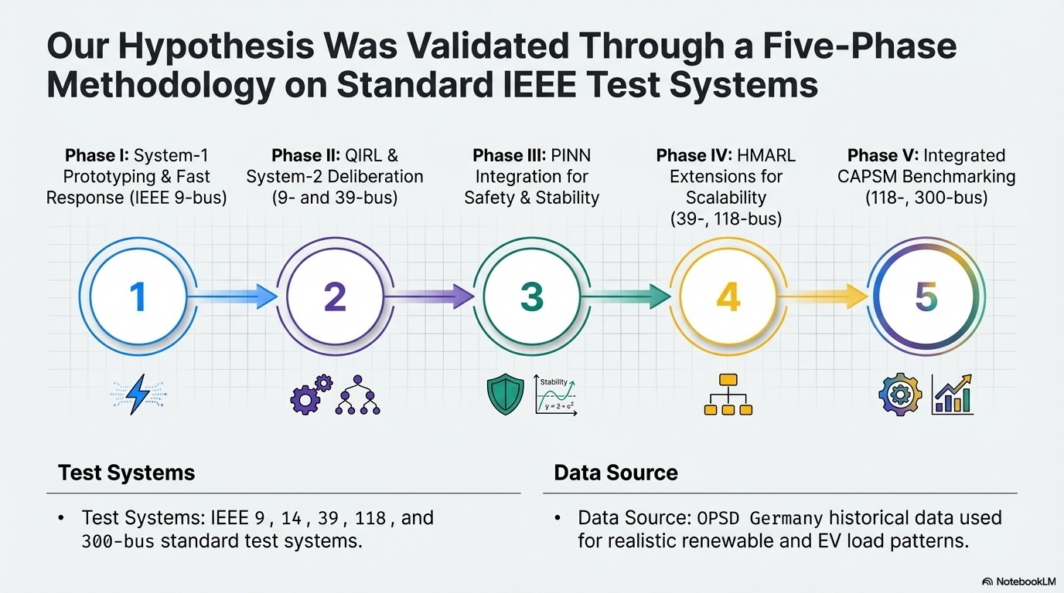
13

Slide 14
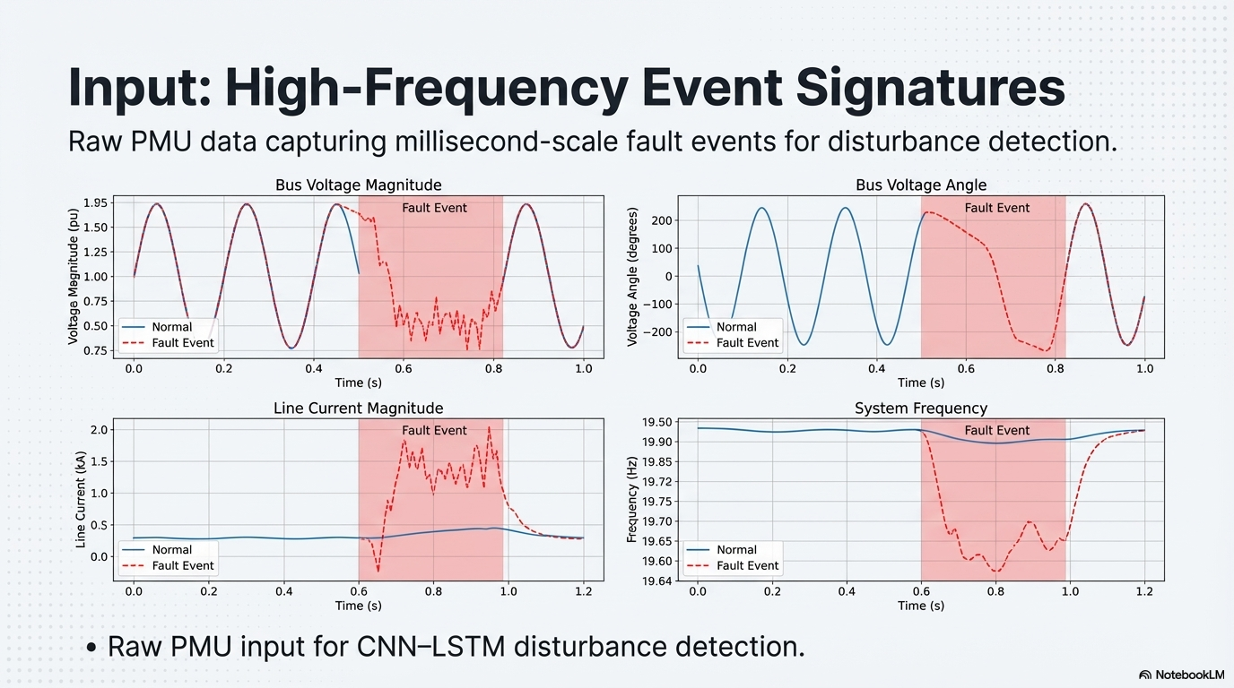
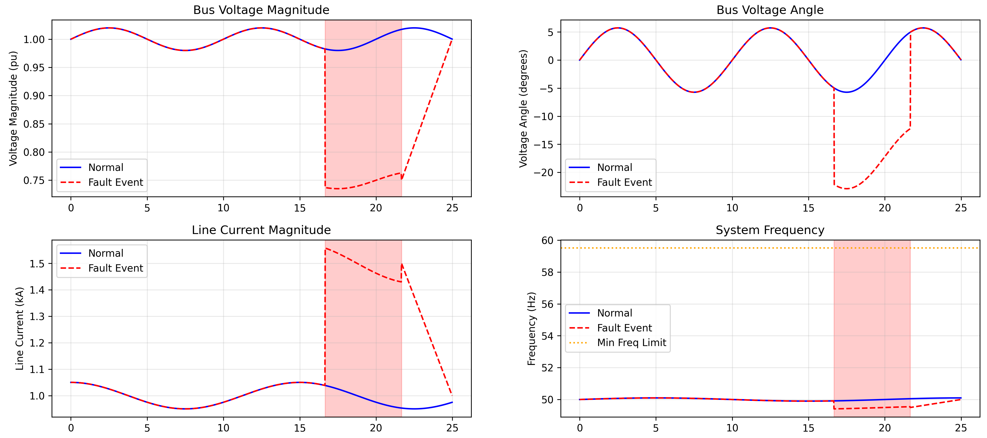
14

Slide 15
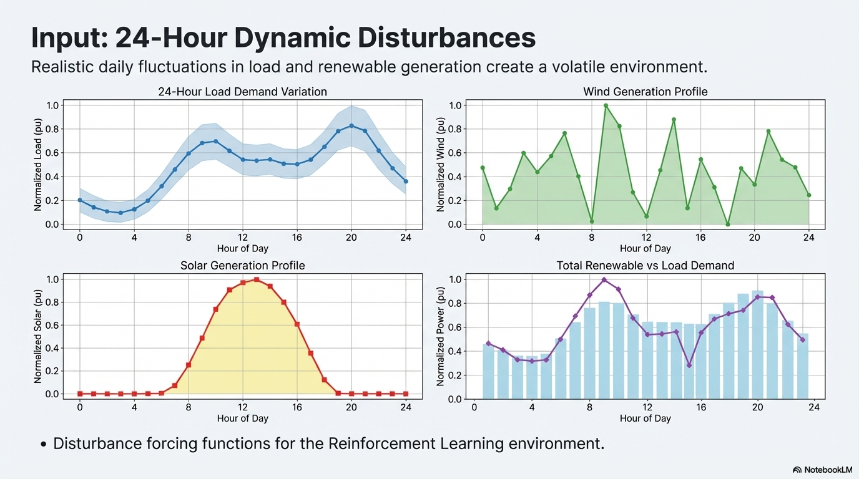
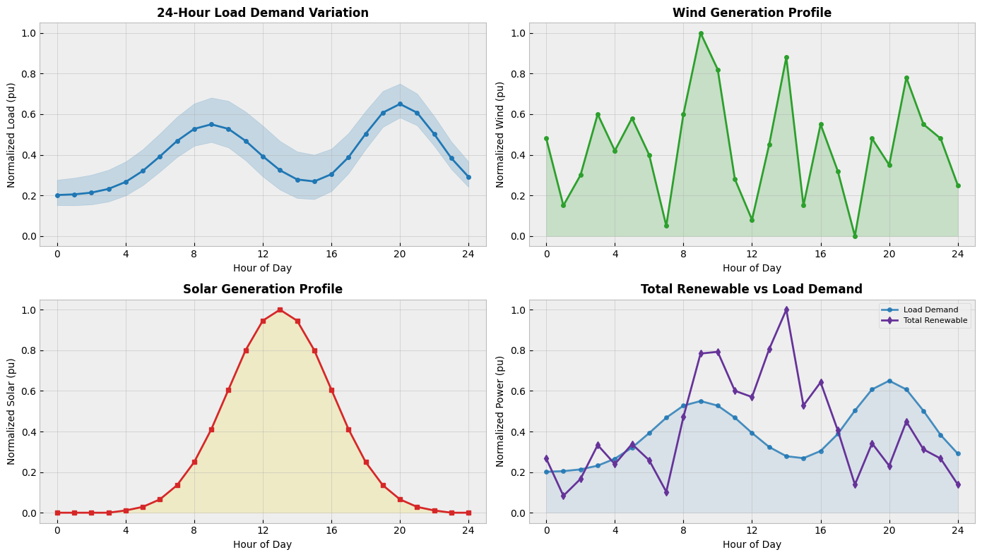
15

Slide 16
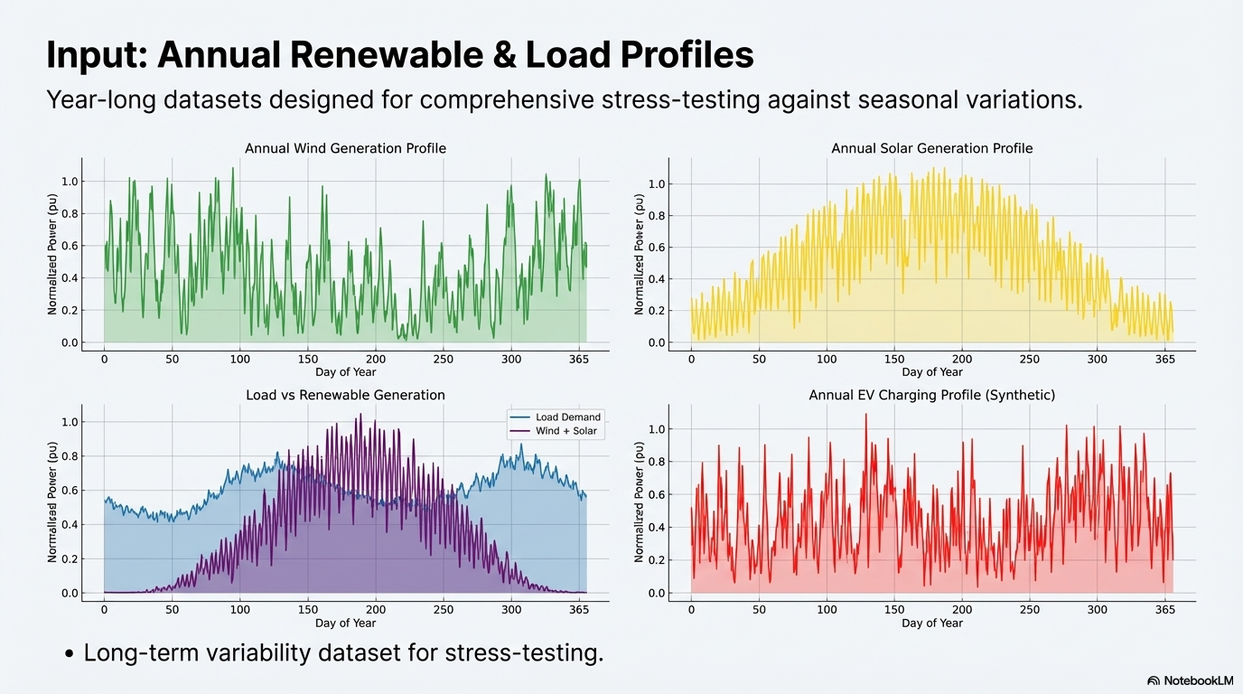
16

Slide 17
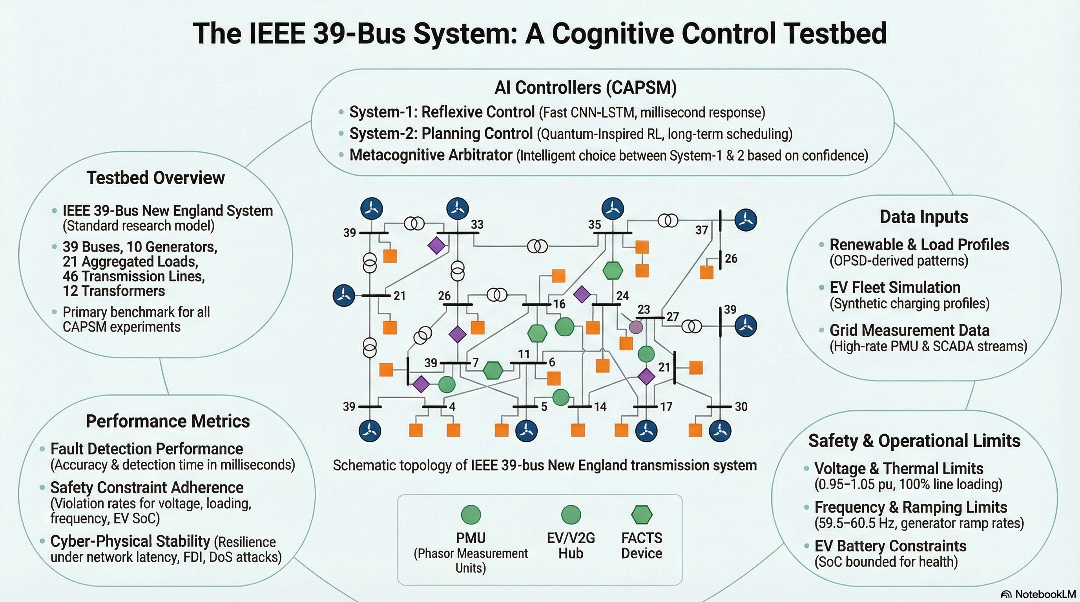
Time-table
17

Slide 18
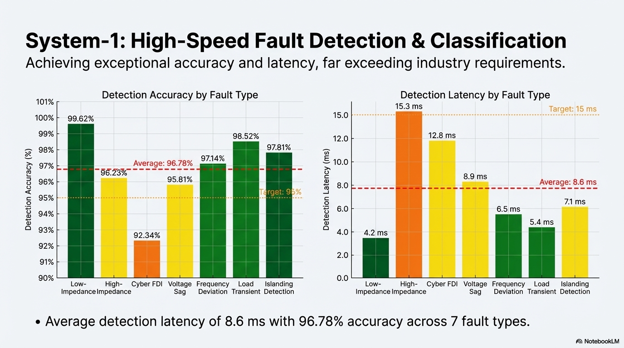
18

Slide 19
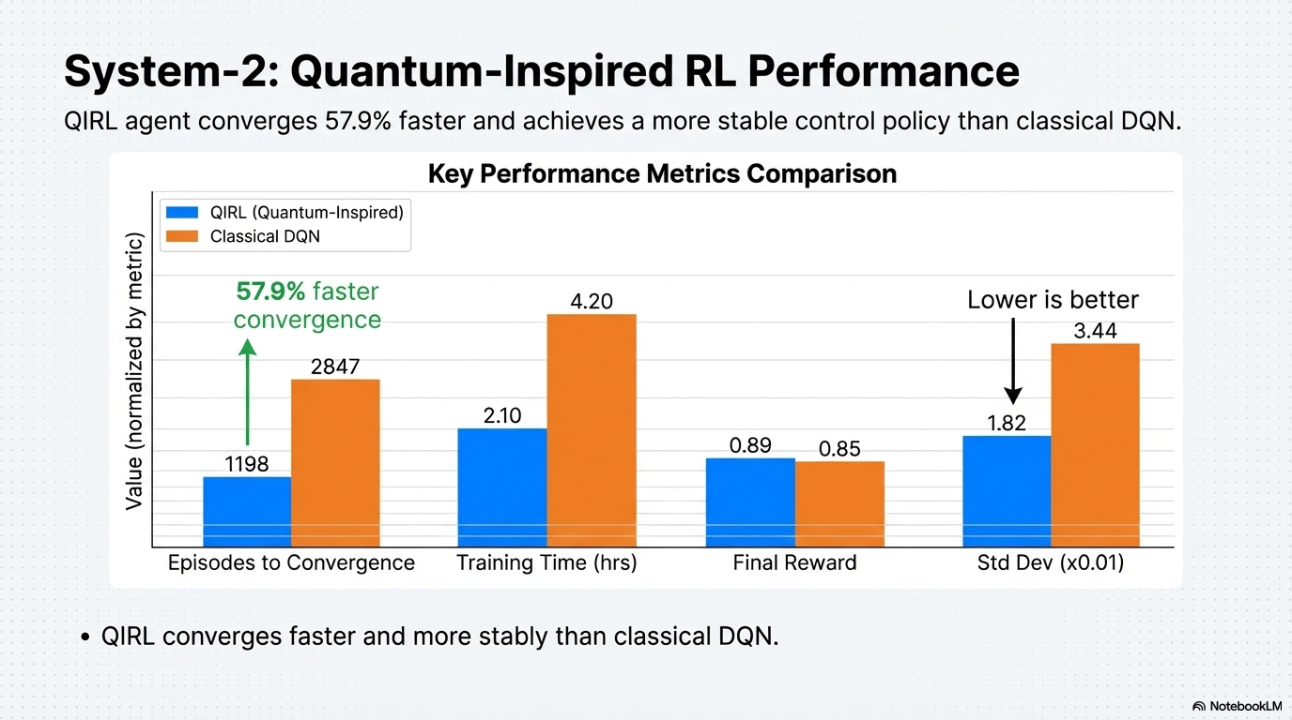
19

Slide 20
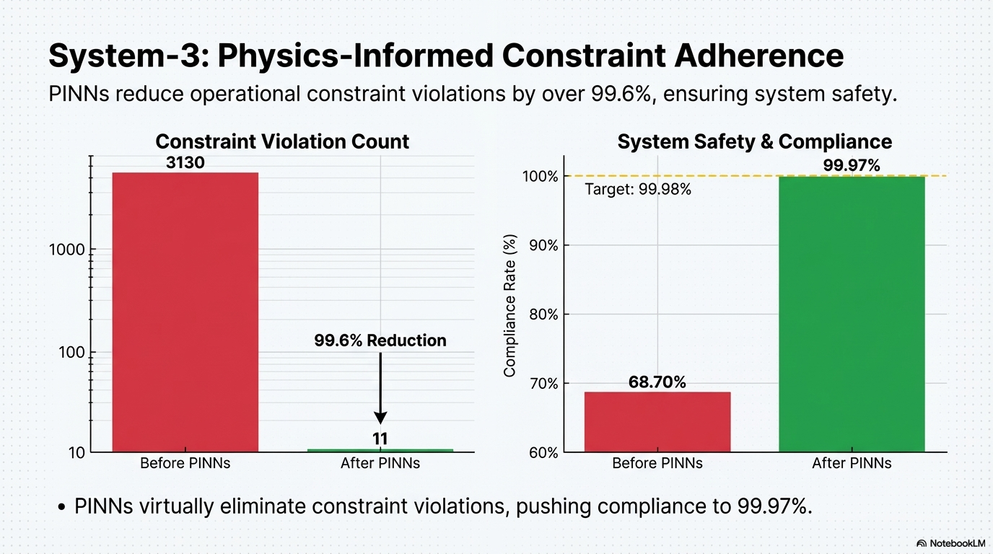
20

Slide 21
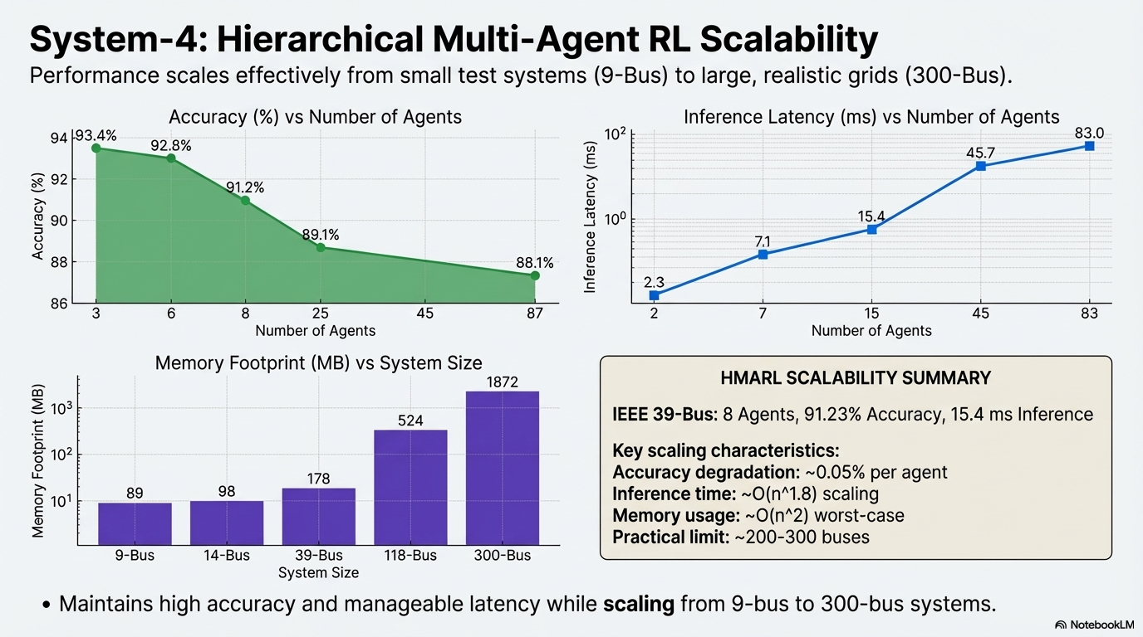
21

Slide 22
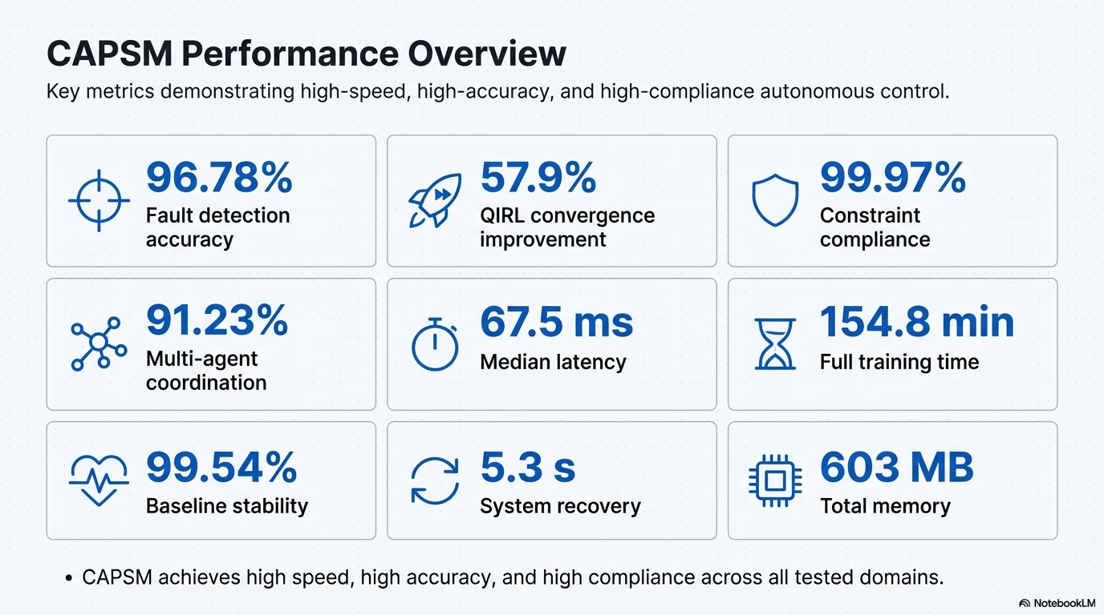
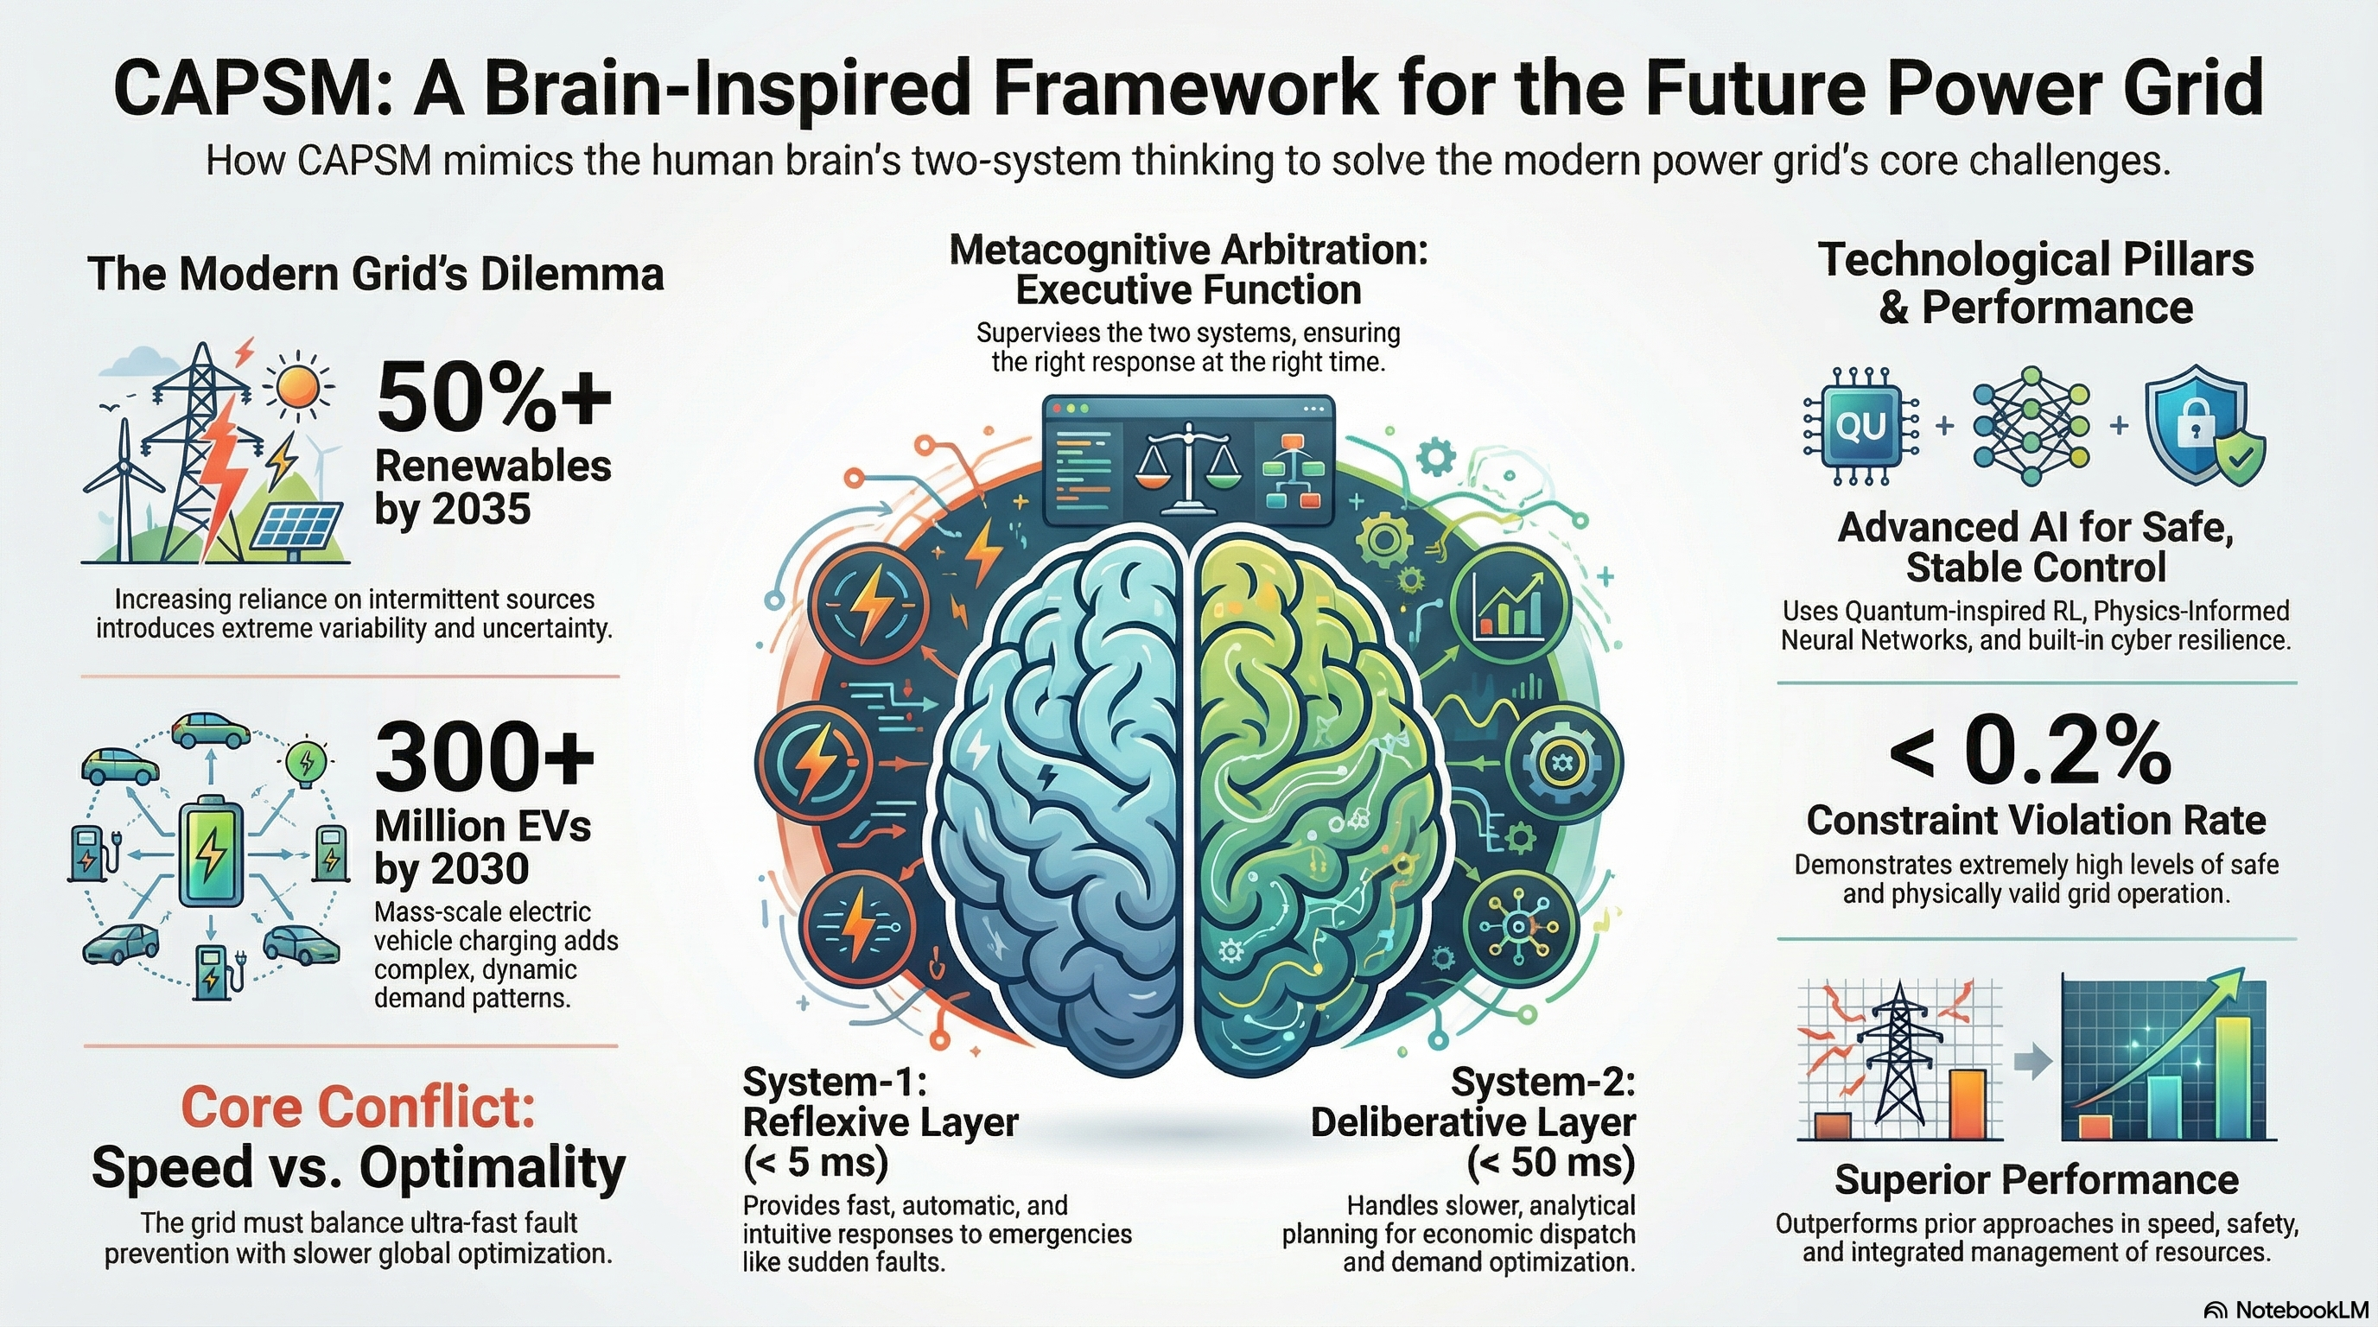
22

Slide 23
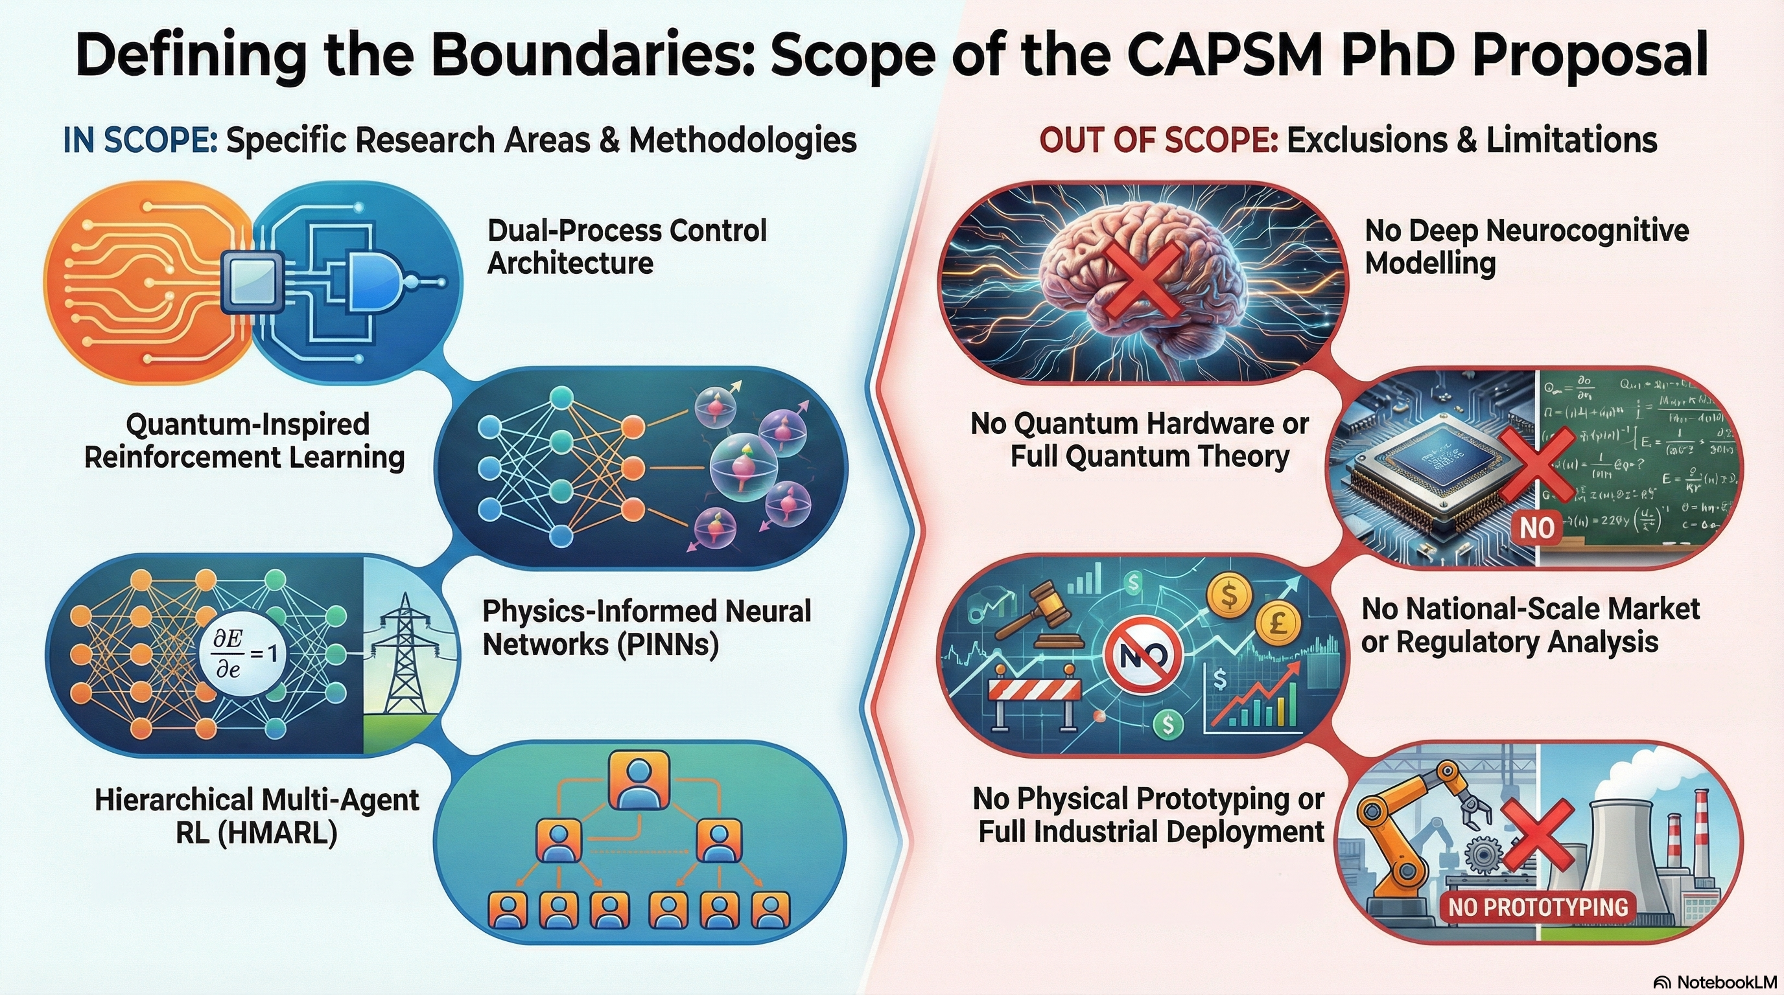
23

Slide 24
References – All
1] P. Karamanakos, E. Liegmann, T. Geyer, and R. Kennel, “Model Predictive Control of Power Electronic Systems: Methods, Results, and Challenges,” IEEE Open J. Ind. Appl., vol. 1, pp. 95–114, 2020, doi: 10.1109/OJIA.2020.3020184.
[2] S. Shahzad, M. A. Abbasi, M. A. Chaudhry, and M. M. Hussain, “Model Predictive Control Strategies in Microgrids: A Concise Revisit,” IEEE Access, vol. 10, pp. 122211–122225, 2022, doi: 10.1109/ACCESS.2022.3223298.
[3] E. Yaghoubi et al., “A Systematic Review and Meta-Analysis of Model Predictive Control in Microgrids: Moving Beyond Traditional Methods,” Processes, vol. 13, no. 7, p. 2197, July 2025, doi: 10.3390/pr13072197.
[4] M. Ghiasi, T. Niknam, Z. Wang, M. Mehrandezh, M. Dehghani, and N. Ghadimi, “A comprehensive review of cyber-attacks and defense mechanisms for improving security in smart grid energy systems: Past, present and future,” Electr. Power Syst. Res., vol. 215, p. 108975, Feb. 2023, doi: 10.1016/j.epsr.2022.108975.
[5] Y. Yasin Ghadi et al., “Security risk models against attacks in smart grid using big data and artificial intelligence,” PeerJ Comput. Sci., vol. 10, p. e1840, Apr. 2024, doi: 10.7717/peerj-cs.1840.
[6] R. R. Hossain et al., “Efficient Learning of Voltage Control Strategies via Model-based Deep Reinforcement Learning,” 2022, arXiv. doi: 10.48550/ARXIV.2212.02715.
[7] S. Nematshahi, D. Shi, F. Wang, B. Yan, and A. Nair, “Deep reinforcement learning based voltage control revisited,” IET Gener. Transm. Distrib., vol. 17, no. 21, pp. 4826–4835, Nov. 2023, doi: 10.1049/gtd2.13001.
[8] P. Wilk, N. Wang, and J. Li, “Multi-Agent Reinforcement Learning for Smart Community Energy Management,” Energies, vol. 17, no. 20, p. 5211, Oct. 2024, doi: 10.3390/en17205211.
[9] P. Yu, Z. Wang, H. Zhang, and Y. Song, “Safe Reinforcement Learning for Power System Control: A Review,” 2024, arXiv. doi: 10.48550/ARXIV.2407.00681.
[10] M. Raissi, P. Perdikaris, and G. E. Karniadakis, “Physics-informed neural networks: A deep learning framework for solving forward and inverse problems involving nonlinear partial differential equations,” J. Comput. Phys., vol. 378, pp. 686–707, Feb. 2019, doi: 10.1016/j.jcp.2018.10.045.
[11] S. Keren, C. Essayeh, S. V. Albrecht, and T. Morstyn, “Multi-Agent Reinforcement Learning for Energy Networks: Computational Challenges, Progress and Open Problems,” 2024, arXiv. doi: 10.48550/ARXIV.2404.15583.
[12] P. Wilk, N. Wang, and J. Li, “Multi-Agent Reinforcement Learning for Smart Community Energy Management,” Energies, vol. 17, no. 20, p. 5211, Oct. 2024, doi: 10.3390/en17205211.
[13] B. A. L. M. Hermans, S. Walker, J. H. A. Ludlage, and L. Özkan, “Model predictive control of vehicle charging stations in grid-connected microgrids: An implementation study,” Appl. Energy, vol. 368, p. 123210, Aug. 2024, doi: 10.1016/j.apenergy.2024.123210.
[14] Open Power System Data Team, “Open Power System Data,” Open Power System Data Project. Accessed: December 02, 2025. [Online]. Available: https://data.open-power-system-data.org/
[15] P. Karamanakos, E. Liegmann, T. Geyer, and R. Kennel, “Model Predictive Control of Power Electronic Systems: Methods, Results, and Challenges,” IEEE Open J. Ind. Appl., vol. 1, pp. 95–114, 2020, doi: 10.1109/OJIA.2020.3020184.
[16] S. Shahzad, M. A. Abbasi, M. A. Chaudhry, and M. M. Hussain, “Model Predictive Control Strategies in Microgrids: A Concise Revisit,” IEEE Access, vol. 10, pp. 122211–122225, 2022, doi: 10.1109/ACCESS.2022.3223298.
[17] R. R. Hossain et al., “Efficient Learning of Voltage Control Strategies via Model-based Deep Reinforcement Learning,” 2022, arXiv. doi: 10.48550/ARXIV.2212.02715.
[18] T. Zhao, J. Wang, and M. Yue, “A Barrier-Certificated Reinforcement Learning Approach for Enhancing Power System Transient Stability,” IEEE Trans. Power Syst., vol. 38, no. 6, pp. 5356–5366, Nov. 2023, doi: 10.1109/TPWRS.2022.3233770.
[19] P. Yu, Z. Wang, H. Zhang, and Y. Song, “Safe Reinforcement Learning for Power System Control: A Review,” 2024, arXiv. doi: 10.48550/ARXIV.2407.00681.
[20] M. Raissi, P. Perdikaris, and G. E. Karniadakis, “Physics-informed neural networks: A deep learning framework for solving forward and inverse problems involving nonlinear partial differential equations,” J. Comput. Phys., vol. 378, pp. 686–707, Feb. 2019, doi: 10.1016/j.jcp.2018.10.045.
[21] H. Bevrani, Robust Power System Frequency Control. Boston, MA: Springer US, 2009. doi: 10.1007/978-0-387-84878-5.
[22] S. Keren, C. Essayeh, S. V. Albrecht, and T. Morstyn, “Multi-Agent Reinforcement Learning for Energy Networks: Computational Challenges, Progress and Open Problems,” 2024, arXiv. doi: 10.48550/ARXIV.2404.15583.
[23] P. Wilk, N. Wang, and J. Li, “Multi-Agent Reinforcement Learning for Smart Community Energy Management,” Energies, vol. 17, no. 20, p. 5211, Oct. 2024, doi: 10.3390/en17205211.
[24] M. Ghiasi, T. Niknam, Z. Wang, M. Mehrandezh, M. Dehghani, and N. Ghadimi, “A comprehensive review of cyber-attacks and defense mechanisms for improving security in smart grid energy systems: Past, present and future,” Electr. Power Syst. Res., vol. 215, p. 108975, Feb. 2023, doi: 10.1016/j.epsr.2022.108975.
[25] Y. Yasin Ghadi et al., “Security risk models against attacks in smart grid using big data and artificial intelligence,” PeerJ Comput. Sci., vol. 10, p. e1840, Apr. 2024, doi: 10.7717/peerj-cs.1840.
[26] B. A. L. M. Hermans, S. Walker, J. H. A. Ludlage, and L. Özkan, “Model predictive control of vehicle charging stations in grid-connected microgrids: An implementation study,” Appl. Energy, vol. 368, p. 123210, Aug. 2024, doi: 10.1016/j.apenergy.2024.123210.
24

Slide 25
References – Part 1
Publication | Relevancy to Thesis
A proposed controller for real-time management of electrical vehicle battery fleet with MATLAB/SIMULINK Elsevier, 2025 | Supplies methods for EV/V2G operational control; forms the basis for EV coordination and System-2 optimization.
A comprehensive review of the current status of smart grid technologies for renewable energies integration and future trends: The role of machine learning and energy storage, Energies, 2024 | Provides foundational context on smart grid challenges; key research gaps motivating the CAPSM architecture are identified.
Enhancing fire protection in electric vehicle batteries through thermal energy storage and machine learning using Simulink, Fire, 2024 | Contributes safety-critical modeling; supports PINN-based constraint enforcement and safety layers.
Evaluating solar power forecasting robustness: A comparative analysis of XGBoost, RNN, KNN, RF, and LSTM with emphasis on lagged steps sensitivity and cross-validation techniques, IEEE Conference, 2024 | Offers renewable variability insights; provides disturbance inputs for RL and planning layers.
Enhancing wind power forecasting accuracy in Canada using a solar data-enhanced hybrid machine learning model: Integrating ANN, LSTM, and SVR, IEEE Conference 2024 | Provides enhanced forecasting methods; strengthens forecast-driven adaptive control.
Comparative analysis of machine learning techniques for an hour-ahead forecasting of electric vehicle states, Master Thesis, 2023 | Improves understanding of EV SoC and charging patterns; supports multi-agent EV modeling and SoC constraints.
AI-driven control strategies for FACTS devices in power quality management: A comprehensive review, Applied Science, 2025 | Identifies FACTS control limitations; directly motivates hierarchical multi-agent coordination (HMARL).
Climate-adaptive residential demand response with power quality-aware optimization using distributed generation systems, Electronics, 2025 | Introduces multi-objective optimization; supports System-2 cost–PQ–stability trade-off modeling.
25

Slide 26
References – Part 2
Prior Approach | Full Supporting Publications
Centralized MPC / OPF for Power Electronics and Microgrids | [15] Model Predictive Control of Power Electronic Systems: Methods, Results, and Challenges (Karamanakos et al.), [16] Model Predictive Control Strategies in Microgrids: A Concise Revisit (Shahzad et al.)
Model-Based Deep Reinforcement Learning for Voltage/Power Control | [17] Efficient Learning of Voltage Control Strategies via Model-based Deep Reinforcement Learning (Hossain et al.)
Safe RL with Barrier Certificates / Lyapunov Stability | [18] A Barrier-Certificated Reinforcement Learning Approach for Enhancing Power System Transient Stability (Zhao et al.), [19] Safe Reinforcement Learning for Power System Control: A Review (Yu et al.)
Physics-Informed Neural Networks (PINNs) | [20] Physics-Informed Neural Networks: A Deep Learning Framework for Solving Forward and Inverse Problems Involving Nonlinear Partial Differential Equations (Raissi et al.)
Heuristic / Classical Frequency and Protection Control | [21] Robust Power System Frequency Control (Bevrani)
Multi-Agent RL for Energy Networks and Smart Communities | [22] Multi-Agent Reinforcement Learning for Energy Networks: Computational Challenges, Progress and Open Problems (Keren et al.), [23] Multi-Agent Reinforcement Learning for Smart Community Energy Management (Wilk et al.)
Cybersecurity and Smart Grid Anomaly Detection | [24] A Comprehensive Review of Cyber-Attacks and Defense Mechanisms for Improving Security in Smart Grid Energy Systems: Past, Present and Future (Ghiasi et al.), [25] Security Risk Models Against Attacks in Smart Grid Using Big Data and Artificial Intelligence (Ghadi et al.)
EV / V2G Dispatch and Charging MPC | [26] Model Predictive Control of Vehicle Charging Stations in Grid-Connected Microgrids: An Implementation Study (Hermans et al.)
26

Slide 27
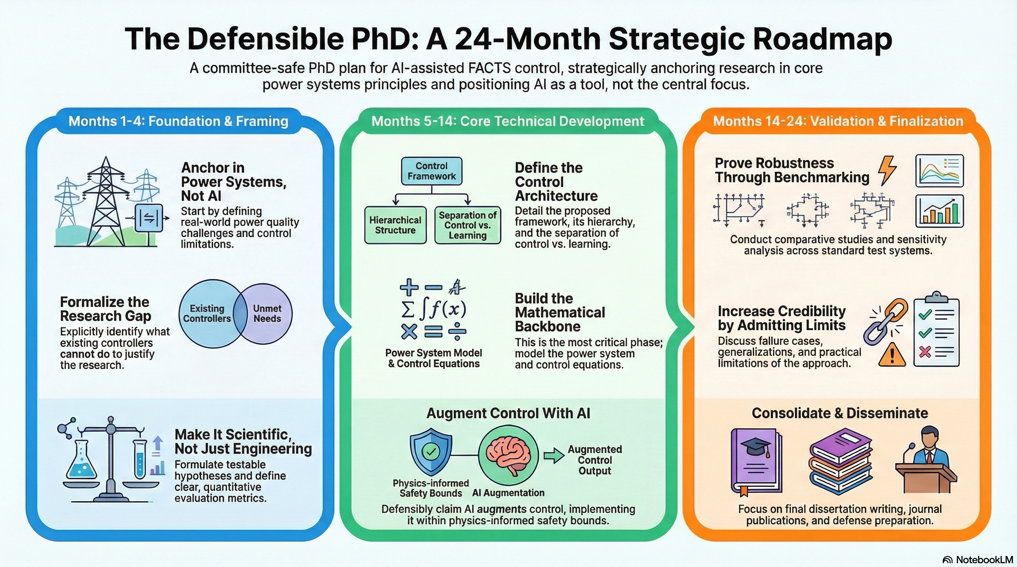
27

